Slide 2
Blank Page

Slide 3
Online Tutorial : Number Four:
Session Four : Functions
  What Is a Function? (4.1)
  Functions with Special Properties (4.2)
  Exponential and Logarithmic Functions (4.3)
  Comparing the Size of Functions (4.4)

Slide 4
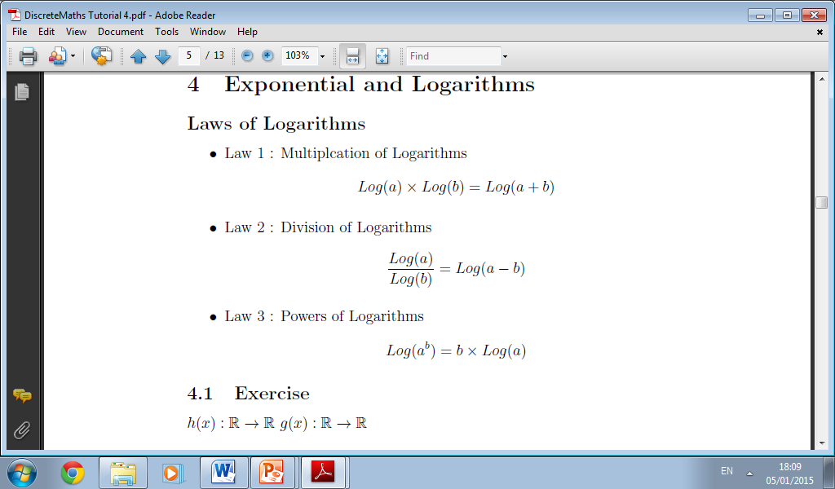

Slide 5
Functions: What is a Function?
  Functions
  Introduction and Definitions
  Arrow Diagram of a Function
  Boolean Functions and ordered n-tuples
  Absolute Value Functions
  Floor and Ceiling Functions
  Polynomial Functions
  Equality of Functions

Slide 6
Exponentials and Powers

Slide 7
Exponentials and Powers

Slide 8
What Is a Function?
Inputs and Outputs
Domain , Co-Domain and Range
Images and Ancestors
Mappings
Arrow Diagrams
Function Value Tables
Boolean functions and Ordered Tuples

Slide 9
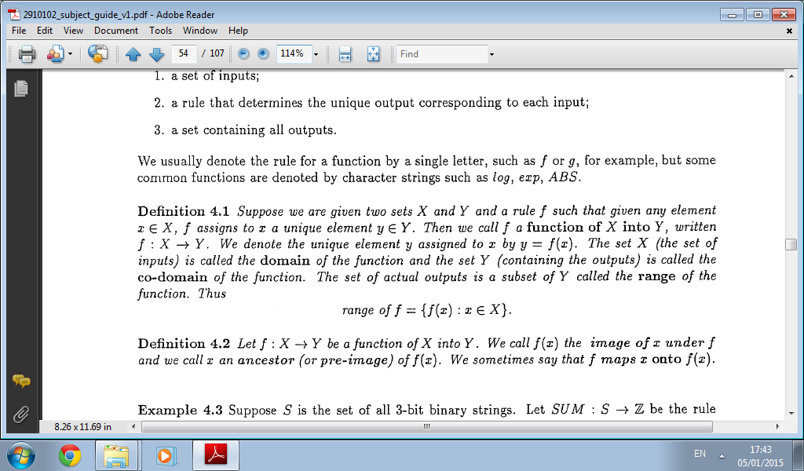
Important Definitions

Slide 10
What is a Function?
A function relates an input to an output.
It must work for every possible input value, and you can only have one relationship for each input value
a function takes elements from a set (the domain) and relates them to elements in a set (the codomain).
all the outputs (the actual values related to) are together called the range
a function is a special type of relation where:
  every element in the domain is included, and
  any input produces only one output (not this or that)

Slide 11
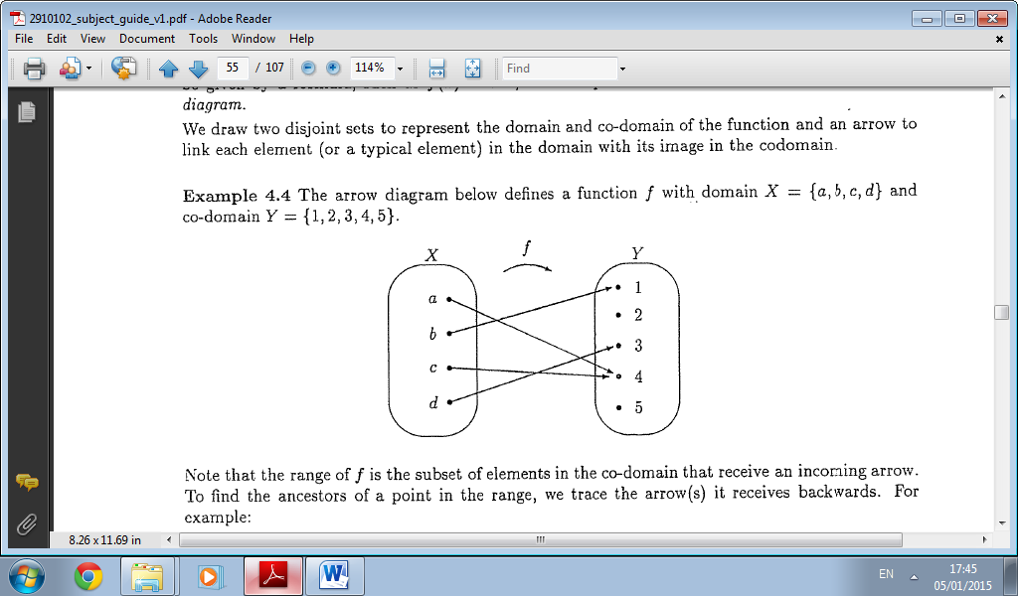
Arrow Diagrams

Slide 12
Blank Page

Slide 13
What is a Function?
an input and its matching output are together called an ordered pair
so a function can also be seen as a set of ordered pairs
A function relates each element of a set with exactly one element of another set (possibly the same set). You can write the input and output of a function as an "ordered pair", such as (3,10).

Slide 14
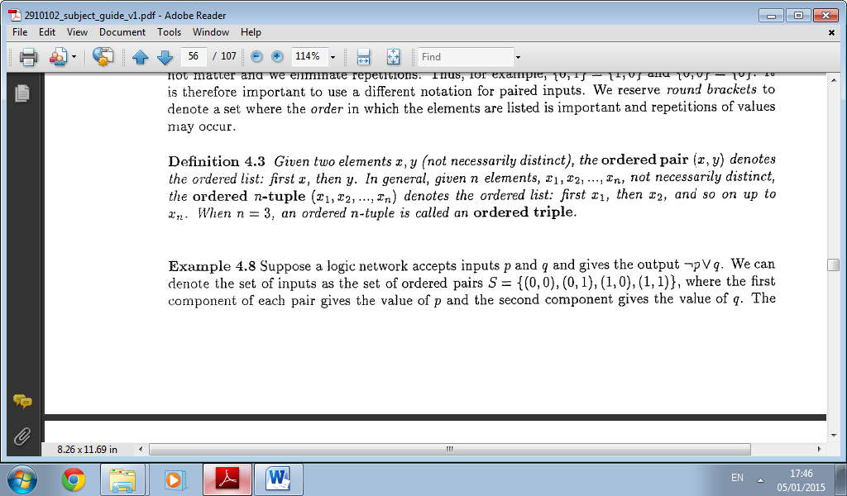
Order Tuples

Slide 15
Functions: What is a Function
  Arrow Diagrams (2010 Zone B Q4 a)
  A function f: X->Y, where X = {p,q,r,s} and Y={1,2,3,4,5} is given by the subset of X x Y. {(q,3),(r,3),(p,5),(s,2)}
  i. Show f as an arrow diagram

Slide 16
Functions: Arrow Diagrams

Slide 17
Functions: What is a Function
  Arrow Diagrams (2010 Zone B Q4 a)
  A function f: X->Y, where X = {p,q,r,s} and Y={1,2,3,4,5} is given by the subset of X x Y. {(q,3),(r,3),(p,5),(s,2)}
  ii. State the domain, co-domain and range of f.
  The domain of this function is {p,q,r,s},
  The co-domain is {1,2,3,4,5}
  The range is {2,3,5}.

Slide 18
Blank Page

Slide 19
Blank Page

Slide 20
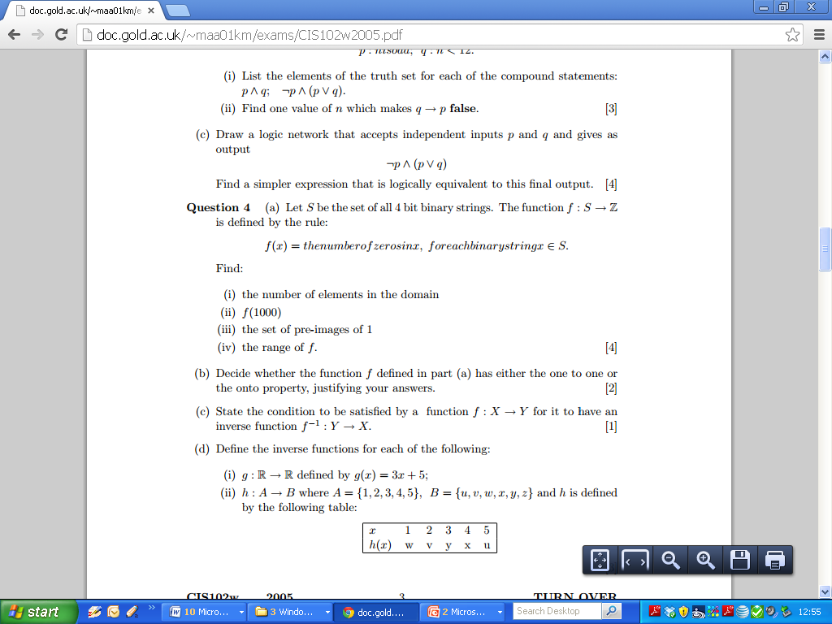
2005 Question 5

Slide 21
2005 Question 5

Slide 22
Functions: Functions with Special Properties
  Functions
  Encoding and Decoding Function
  Onto Functions
  One-to-One Functions
  Inverse Functions
  One to One Correspondence

Slide 23
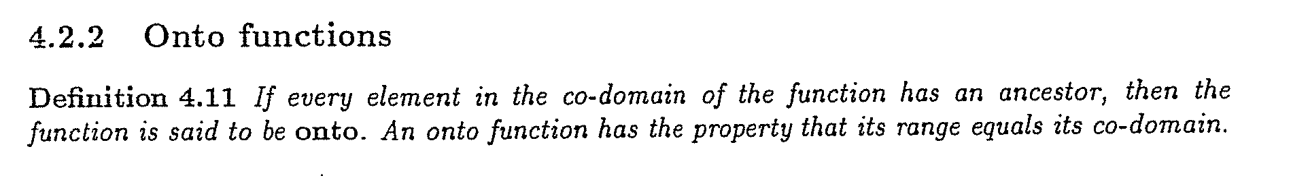
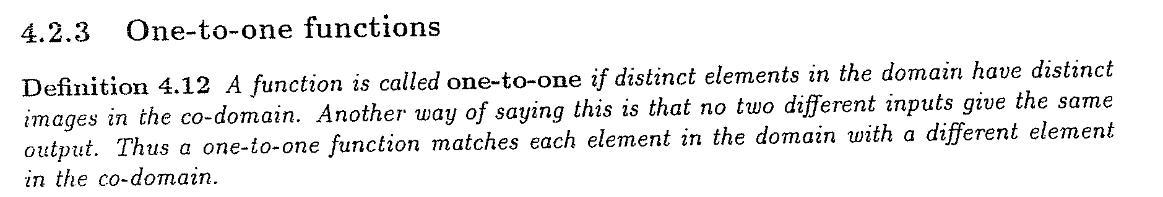
Functions: Functions with Special Properties

Slide 24
Functions: One to One
  Arrow Diagrams

Slide 25
Functions: Onto
  Arrow Diagrams

Slide 26
Functions: One to One and Onto
  Arrow Diagrams

Slide 27
Functions: What is a Function
  Arrow Diagrams (2010 Zone B Q4 a)
  A function f: X->Y, where X = {p,q,r,s} and Y={1,2,3,4,5} is given by the subset of X x Y. {(q,3),(r,3),(p,5),(s,2)}
  iii. Say why f does not have the one-to-one property and why f does not have the onto property, giving a counter example in each case.

Slide 28
Functions: What is a Function
  Arrow Diagrams (2010 Zone B Q4 a)
  A function f: X->Y, where X = {p,q,r,s} and Y={1,2,3,4,5} is given by the subset of X x Y. {(q,3),(r,3),(p,5),(s,2)}
  iii. Say why f does not have the one-to-one property and why f does not have the onto property, giving a counter example in each case.
  -The function is not one-to-one because 3 in the co-domain has more than one ancestor, i.e. p and q.
  -The function is not onto because 1 and 4 in the co-domain have no ancestors.

Slide 29
Functions: Functions with Special Properties
  Inverse of Functions (2010 Zone B Question 4 part b).
  1. State the condition to be satisfied in order for an function to have an inverse.
  (N.B. Very formal definition required – see Definition 4.14 page 56)

Slide 30
Functions: Inverse Functions

Slide 31
Functions: Inverse Functions

Slide 32
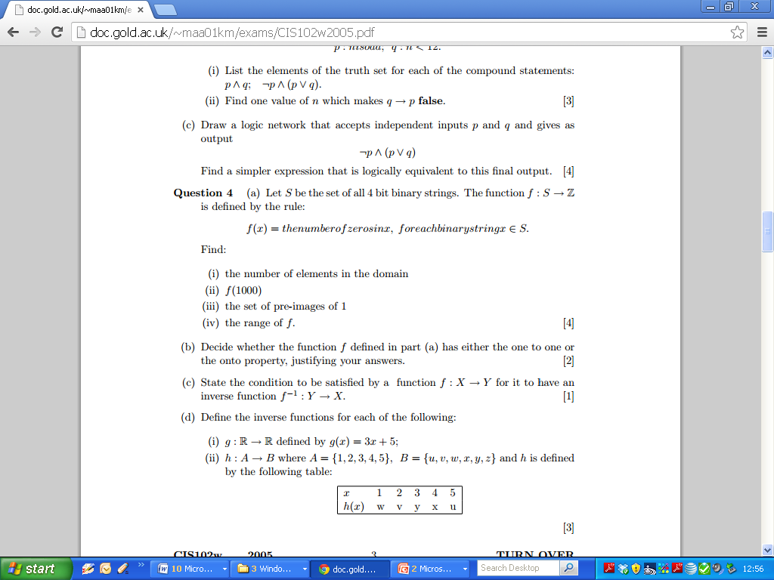
2005 Question 4 part d

Slide 33
2005 Question 4 part d

Slide 34
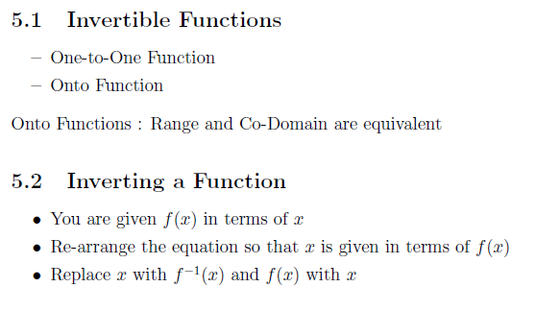
Invertible Functions

Slide 35
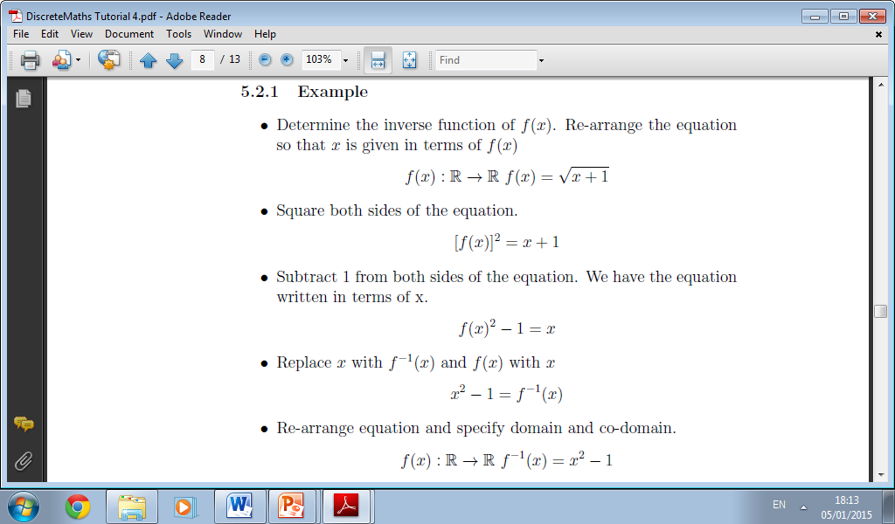
Invertible Function Example (part 1)

Slide 36
Invertible Functions (Part 2)

Slide 37
2004 Question 4

Slide 38
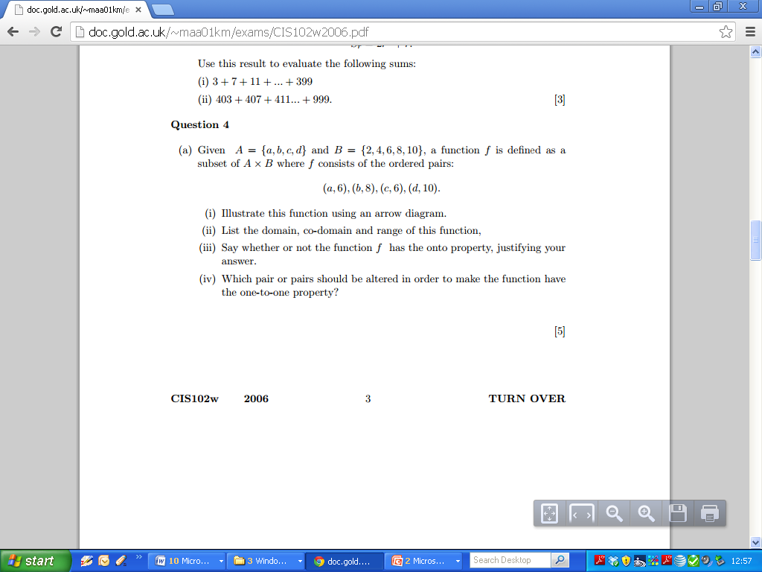
2006 Q4

Slide 39
2006 Question 4

Slide 40
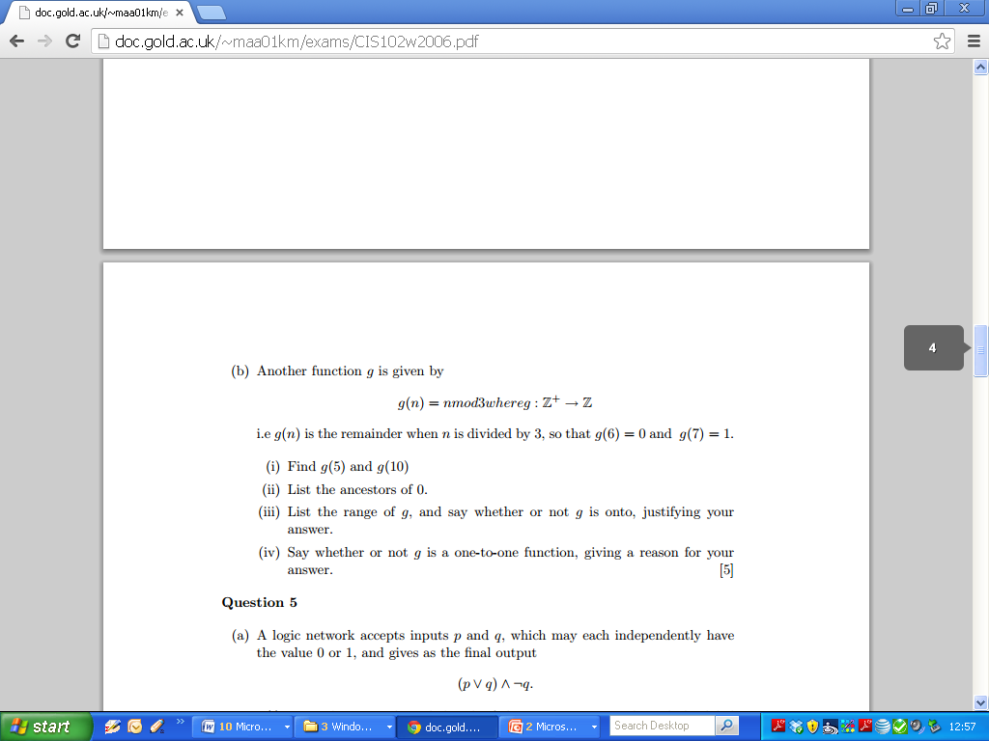
2006 Question 4

Slide 41
2006 Question 4

Slide 42
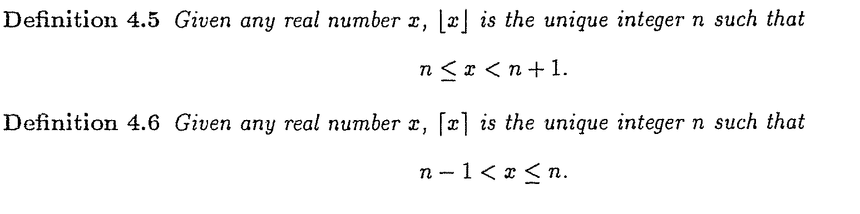
Functions: Floor and Ceiling Functions

Slide 43
Functions: Floor and Ceiling Functions
  Page 67 Q5: Find the floor and ceiling of the following numbers.
Number | Floor | Ceiling | Absolute Value | Fractional Part
-1.4
2.3
7/9
-16/3
0
1

Slide 44
Functions: Floor and Ceiling Functions
Number | Notes | Floor | Ceiling | Fractional Part
1 |  | 1 | 1 | 0
0 |  | 0 | 0 | 0
3.1 |  | 3 | 4 | 0.1
3.141593 |  | 3 | 4 | 0.1416
1.414214 |  | 1 | 2 | 0.4142
-3.6 |  | -4 | -3 | 0.4
-3 |  | -3 | -3 | 0
2.5 |  | 2 | 3 | 0.5
4 |  | 4 | 4 | 0
5 |  | 5 | 5 | 0

Slide 45
Polynomial Functions
Constants
Linear
Quadratic
Cubic

Slide 46
Functions: Exponential and Logarithmic Functions
  Exponential and Logarithmic Functions
  Exponential Functions
  Laws of Exponents (Section 4.3.1)
  Logarithmic Functions (section 4.3.2)
  Base of Logarithms and the Natural Logarithm
  Laws of Logarithms (Rules 4.23)
  Change of Base ( Rule 4.24)

Slide 47
Functions: Exponential and Logarithmic Functions
  Exponential and Logarithmic Functions
  Laws of Exponents (Section 4.3.1)

Slide 48
Functions: Exponential and Logarithmic Functions
  Exponential and Logarithmic Functions
  Laws of Logarithms (Rules 4.23)

Slide 49
Functions: Exponential and Logarithmic Functions
  (Page 67 Q 10) Without using your calculator, find the value of the following numbers.
Number | Workings 1 | Workings 2 | Answers
Log 2128
Log2(4√2)
Log2(1/8)
Log2(√2/16)

Slide 50
Functions: Exponential and Logarithmic Functions
  (Blank Page)

Slide 51
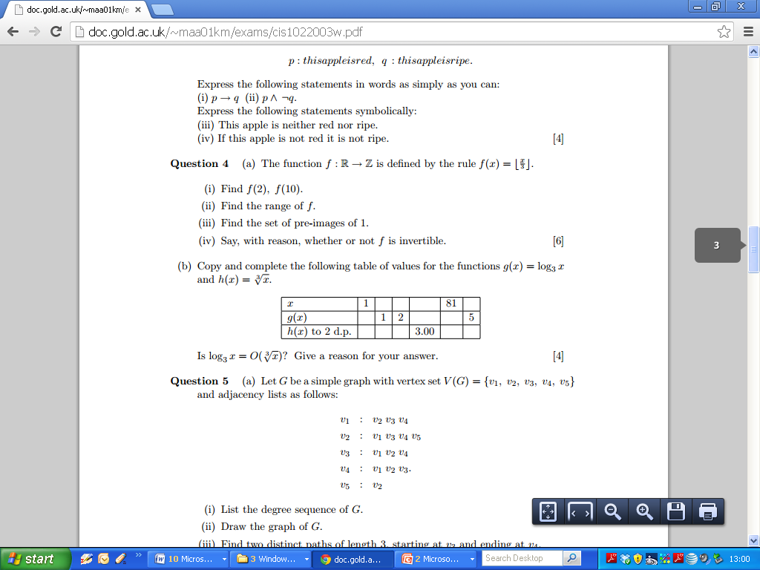
2003 Question 4

Slide 52
2003 Question 4

Slide 53
Functions: Exponential and Logarithmic Functions
  (Blank Page)

Slide 54
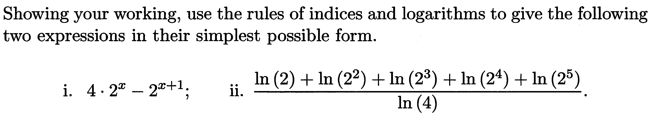
Functions: Exponential and Logarithmic Functions
(2012 – Question 4a)

Slide 55
Functions: Exponential and Logarithmic Functions

Slide 56
Functions: Inverse Functions

Slide 57
Functions: Inverse Functions

Slide 58
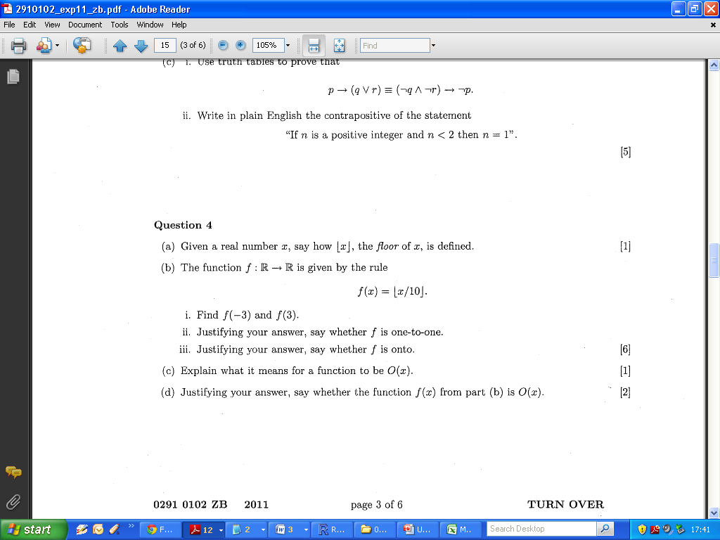
Functions: Inverse Functions
- 2011 Zone B Q4 b

Slide 59
Functions: Inverse Functions
- 2011 Zone B Q4 b

Slide 60
Functions: Comparing Functions
  Comparing Functions
  O-notation
  Power Functions
  Orders of Polynomial Functions
  Comparison of Algorithms

Slide 62
Venn Diagram / Blank Page

Slide 63
Venn Diagram / Blank Page

Slide 64
Venn Diagram / Blank Page

Slide 65
Venn Diagram / Blank Page

Slide 66
Venn Diagram / Blank Page

Slide 67
Venn Diagram / Blank Page

Slide 68
Venn Diagram / Blank Page

Slide 69
Venn Diagram / Blank Page

Slide 70
Venn Diagram / Blank Page

Slide 71
Venn Diagram / Blank Page

Slide 72
Venn Diagram / Blank Page

Slide 73
Venn Diagram / Blank Page

